Slide 1



MatriCare AI
AI-based Prediction of Labour -related Complications
Intelligent maternal healthcare system for early detection and critical intervention.
Team Members:
Zaid Sutar
Varsha Devdas
Sakshi Bhumkar
Aditya Kambale
Under the guidance of
- Prof. G.N. Chanderki
Notes:
1

Slide 2


CHAPTER 1: THE URGENCY
The Global Maternal Health Crisis
Maternal mortality remains a grave global public health challenge, with hundreds of women dying every day from largely preventable causes. The disparity between high-income and low-resource settings is unacceptable and demands intelligent, urgent solutions.
800+ Deaths Daily
94% of Deaths
75% Preventable
Women die from preventable pregnancy-related causes (WHO 2023).
Occur in low- and middle-income countries (WHO).
Attributed to hemorrhage, hypertension, and infection (UNFPA & WHO).
Notes:
2

Slide 3

The Scale of the Problem in Focus
While the global Maternal Mortality Ratio (MMR) is 223/100,000, high-income countries maintain an MMR of only 12/100,000. In India, despite progress, the nation is still working towards the UN SDG target of 70 by 2030, highlighting critical gaps in monitoring infrastructure.
Global Impact & Prevention
The India Challenge
Current MMR is 97/100,000 live births (2023).
Preeclampsia and Postpartum Hemorrhage (PPH) cause over 40% of maternal deaths.
70% of rural health centers lack the capacity for continuous maternal monitoring (NITI Aayog, 2022).
66%
Fewer than half of healthcare workers have access to real-time decision support tools (World Bank, 2023).
Potential complications that could be prevented through timely, continuous monitoring (The Lancet, 2022).
Most maternal deaths occur within 24 hours of delivery, making real-time, AI-driven monitoring an essential life-saving tool during this critical window.
Notes:
3

Slide 4




CHAPTER 2: OUR SOLUTION
MatriCare AI: Focused Objectives
We are deploying an AI-driven solution specifically designed to address the monitoring and decision-support deficits in vulnerable healthcare settings. Our goal is to transform reactive care into proactive intervention.
Auto Monitoring
Real-Time Support
Bridge the Gap
Develop a robust AI-driven system capable of predicting specific pregnancy-related complications before they become critical events.
Provide immediate, contextual decision support for both doctors and nurses, optimizing response time during emergencies.
Implement technology that is affordable, scalable, and effective in low-resource and rural settings, ensuring equitable access to advanced care.
Notes:
4

Slide 5
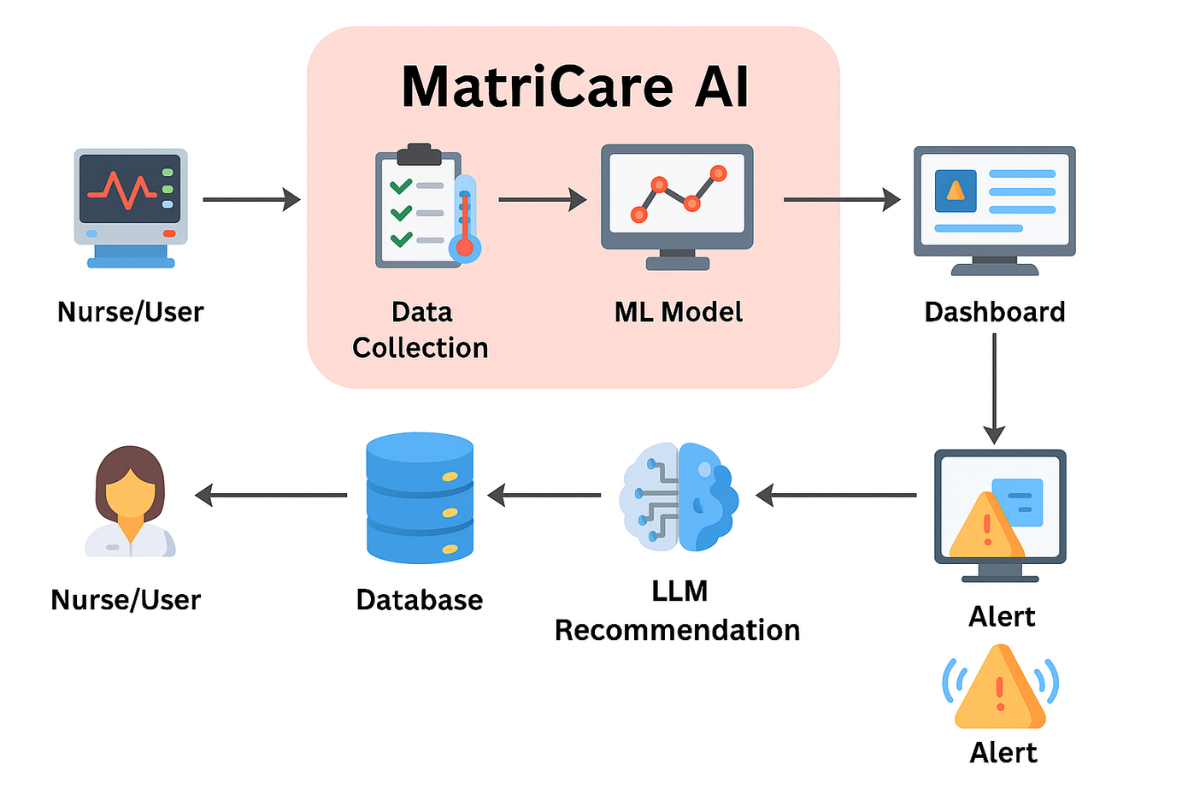
The MatriCare AI Workflow
Our system operates through a seamless, automated loop, integrating continuous data streams with advanced Machine Learning (ML) and Large Language Model (LLM) interpretation to deliver actionable clinical insights.
Notes:
5

Slide 6
CHAPTER 3: ARCHITECTURE & RESULTS
Technology Stack Overview
The MatriCare AI solution is built on a modular, efficient, and cost-effective stack, leveraging established open-source tools for rapid deployment and scalability across various hospital IT environments.
Frontend
HTML, CSS, JavaScript (for responsive and intuitive dashboards)
Backend Framework
Flask (Python) – Lightweight and robust web server
Machine Learning Model
Random Forest (Selected for high accuracy and interpretability)
Language Model (LLM)
Gemma 2:2b via Ollama (For clinical interpretation and suggestion generation)
Data/Storage
final_data.xlsx, JSON, Pandas, Joblib
Visualization
Chart.js (For dynamic, clear data visualization)
This combination ensures rapid prediction and response while minimizing resource requirements, crucial for low-resource centers.
Notes:
6

Slide 7




Key Achievements and Operational Insights
MatriCare AI has successfully demonstrated its capacity to deliver accurate predictions and contextual support in simulated clinical environments, validating its potential to improve patient outcomes.
Accurate Prediction
Contextual Action
Achieved high accuracy in real-time classification of patient status (Stable, Moderate, Critical).
LLM provides layered suggestions: basic actions (nurse) and advanced protocols (doctor).
Improved Response
Modular Integration
Demonstrated improved response time for medical staff in high-stress, simulated complication cases.
Modular design enables easy integration with various existing and future IoT medical devices and hospital systems.
The ability to dynamically visualize risk and provide differentiated guidance for staff roles is a significant leap forward in maternal emergency preparedness.
Notes:
7

Slide 8

CHAPTER 4: MARKET & ROADMAP
Market Landscape & Competitive Advantage
Current monitoring systems are often focused on fetal metrics, lack
deep AI integration for risk prediction, and are prohibitively
expensive for rural settings. MatriCare AI fills this critical gap
with a holistic, intelligence-driven maternal focus.
Currently Available Systems
Keyar "CM Patch" (Janitri): Wireless patch for Fetal/Maternal ECG.
Philips Avalon CL System: Cordless maternal/fetal monitoring.
VitalTrace DelivAssure: Microneedle-based fetal lactate sensor.
NEC/Melody iCTG Monitor: Wearable FHR and contraction monitoring.
.
Notes:
8

Slide 9




Future Scope:
Our roadmap focuses on expanding system functionality, integrating with wider healthcare ecosystems, and enhancing accessibility through advanced user interfaces.
Cloud Connectivity
Voice AI Assistant
Establish cloud-based data analytics for trend analysis, long-term patient data tracking, and hospital system integration.
Develop a voice-guided AI assistant to aid nurses with low literacy or in high-pressure, low-resource environments.
Advanced Alerts
Multilingual Support
Implement enhanced predictive alert systems specifically for high-risk conditions like Preeclampsia and Postpartum Hemorrhage (PPH).
Add regional language options for wider accessibility in diverse healthcare settings.
Notes:
9

Slide 10



CHAPTER 5: CALL TO ACTION
Proactive Care, Proven Impact
Conclusion: Investing in MatriCare AI
MatriCare AI is more than a technology platform; it is a critical intervention tool that formalizes the pathway from data to life-saving action. By empowering healthcare providers with real-time, actionable insights, we can significantly reduce the risk associated with childbirth.
1
2
3
Bridge the Gap
Empowerment
Fulfilling SDG 3.1
Provides crucial AI-based decision support where clinical expertise is scarce or overburdened.
equips nurses and doctors with precise, immediate guidance tailored to the patient's condition.
A critical step toward achieving the global target of reducing the maternal mortality ratio below 70 by 2030.
Notes:
10

